Slide 1
Endpoints Operations
Monthly Operations Summary
JL IT
January 2023

Slide 2
Executive Summary
Incident Management Summary
Service Desk Summary
Technology Operations Summary
Endpoint Engineering Summary

Slide 3
Executive Summary
Incident Management saw incident volume lower in December (2,605). The first call resolution, or FCR, was 85.6%. The overall SLA goal across all teams was not met at 89.2%.
Service Desk call volume dropped to 2169 calls in December. Calls answered within 30-, 60-, and 90- seconds goals were surpassed. Average speed to answer was 35 seconds. The abandonment rate goal for the month was also surpassed at 7.15%. SLA goals were met by the Service Desk with an overall SLA score of 96.9%.
Technology Operations assignment groups opened or received 345 incidents across the month with 40 being escalated to Engineering. Critical Alerts increased from 62 to 100 in December. This was due to the San Diego move which was placed in SDT but alerts are generated only in Logic Monitor. Error alerts remain the same with the same alerts being CPU, Reboots and Status of devices. NBI and JL - Home had uptime % drop due to errors from logic monitor probing.
Endpoint Engineering Successfully deployed Egress Protect and associated CSPs firmwide with close to 100% adoption. NetDocs ndOffice 3.1.0 Suite currently on a third(672) of the fleet, also with IE11 Feature removed from this same scope. Central Region 1 for Litera succeeded in mid Jan 2023 with high adoption. More GPO elements are now provided by Endpoint Manager with no need from GPO. 8x8 Network Utility current in prelim stage. Jamf-Intune migration nearing completion to utilize conditional access on our small fleet of MacBooks.

Slide 4
Incident Management

Slide 5
Incident Statistics
3,134 incidents were opened during the month, across all groups within SNOW. 21.1% of incident volume were email.
Phone: 2334
Email: 660
Self-Service: 78
Walk-in: 60
Chat: 2
First contact resolution decreased slightly in January to 85.1% (as opposed to 85.6% in December).

Slide 6
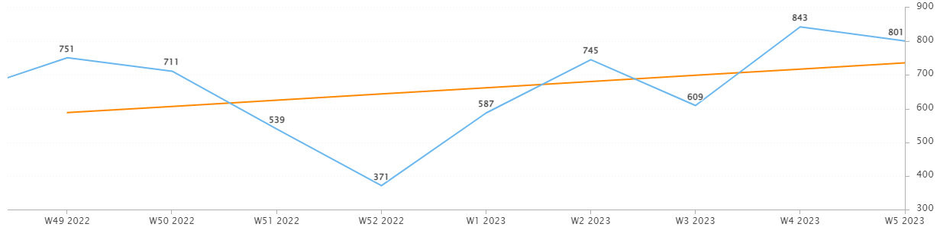
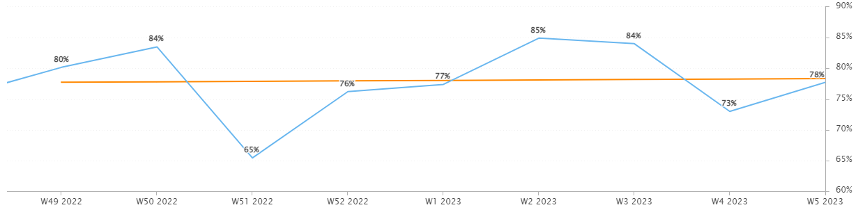
Incident Statistics
Incidents Opened by Week
Incidents opened by week trended upward in January after passing the holidays.
The percentage of incidents resolved the same day that they were opened was lower in the last two weeks of the month. During those weeks we saw a higher volume of incidents.
Percentage of incidents resolved; same day opened.

Slide 7
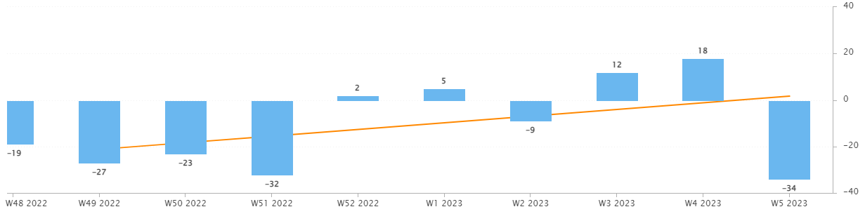
Incident Statistics
Open Incident Backlog Growth
Backlog growth remained low in January.
Notes:
Backlog growth is a way of answering, “did we end the week with more or less incidents?”.

Slide 8
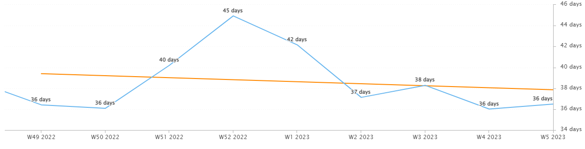
Incident Statistics
Average Age of Open Incidents
In January, the average age of open incidents steadily declined week over week.
Notes:
Please remind your teams to continue to work on their open incidents- this affects many of the previous slides as well as this one.

Slide 9
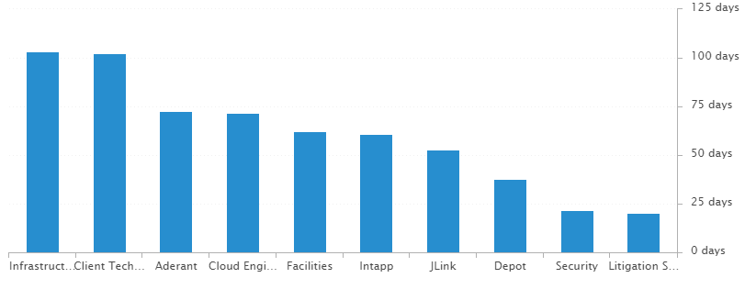
Incident Statistics
Average Age of Open Incidents by Assignment Group - as of the last day of the month

Slide 10
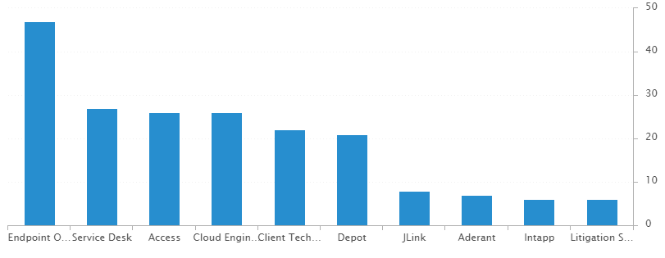
Incident Statistics
Open Incidents by Assignment Group - as of the last day of the month
There are currently 218 open incidents across all teams.

Slide 11
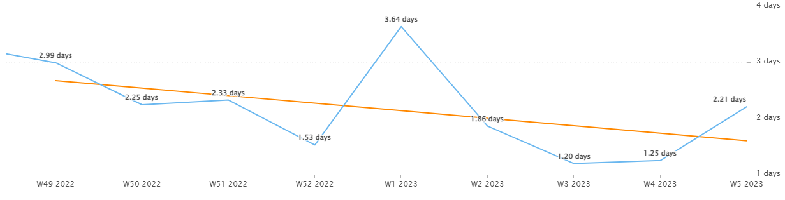
Incident Statistics
Average Resolution Time of All Resolved Incidents
The average resolution time trended downward across the last two months.

Slide 12
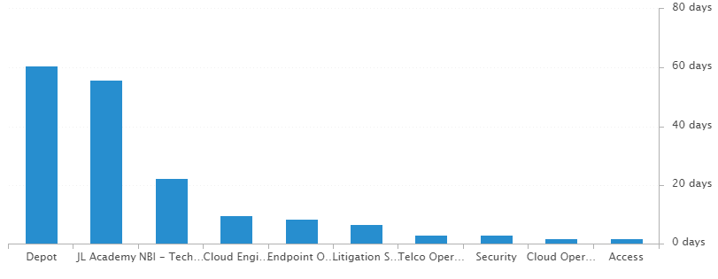
Incident Statistics
Average Resolution Time of Resolved Incidents, by Assignment Group

Slide 13
Incident Statistics
Top 5 Subcategories this month:
Microsoft Office (628)
NetDocuments (343)
Active Directory (255)
Windows OS (151)
Add-ins (122)
Top 5 Resolved By this month:
(highest volume of resolved Incidents)
Dan (345)
Blaise (337)
Stephane (311)
Brandon (283)
Chris (281)
Top 5 Assignment Groups (Tier 2) this month:
Endpoint Operations (117)
Cloud Operations (102)
Access (64)
Telco Operations (46)
Network Ops (9)
Top 5 Assignment Groups (Tier 3) this month:
Cloud Engineering (51)
Intapp (27)
Jlink (22)
Security (17)
Client Technology (7)

Slide 14
Incident Statistics
Top 10 Customers this month:
Nancy Batchelder (32) (NH, 1/4/23)
Primarily around peripheral issues, Cisco phone issues, Stamps in PDF, and assistance with Microsoft Office applications.
In discussions with Martha Tanner, she onboarded this user remotely and thought this was the primary reason for the spike in incidents.
Beth Davis (24)
Carol Garrity (17) (NH, 1/3/23)
Elissa Ali (17)
Rose Senenko (16)
Suddie Scott (16)
Youli Comfort (16)
Ann Rake (15)
Denise Schowe (15)
Jing Tong (15)
Notes:
Across the month _had the highest number of related incidents.
Top 5 customers in the month are listed here.
Looking at the chart, we’re tracking incident volume per new-hire per month and comparing this to last year.

Slide 15
2022 SLA Goals & Actuals
Month | January | February | March | April | May | June | July | Aug | Sept | Oct | Nov | Dec
Goal | 90% | 90% | 90% | 90% | 90% | 90% | 90% | 90% | 90% | 90% | 90% | 90%
Actual | 91.9%
SLA score for last year was 90.85%.
The Incident SLA goal was met in January.

Slide 16
Problem Statistics
Open Problems
Problem | Date of most recent update | Assignment Group
PRB0010189 | 2023-01-10 | Cloud Engineering
PRB0010587 | 2023-01-12 | Cloud Engineering
PRB0010598 | 2023-01-30 | Cloud Engineering
PRB0010606 | 2023-02-03 | Endpoint Engineering
PRB0010617 | 2023-01-27 | Endpoint Operations
PRB0010634 | 2023-02-03 | Endpoint Engineering
PRB0010657 | 2023-01-03 | Cloud Engineering
PRB0010673 | 2023-02-06 | Endpoint Engineering
Did you know?
PRB marked in Red have not been updated within the last month. ->

Slide 17
Service Desk

Slide 18
Year over Year Quarterly Results
Total incident and call volume reduced in Q4 2022 over 2021.

Slide 19
Key Call Statistics
Call volume elevated to 2621 calls in January.
The goal was met with a strong start for the year as it ended with 6.7%.
The abandonment rate monthly goal in 2022 was 9%. We’ve ambitiously lowered the ceiling of the goal to 8% for 2023.
Notes:
~
There are several stats tracked for individual analysts as well as for the team and the org. Across the next few slides I’ll highlight some key statistics for the Service Desk team.

Slide 20
Key Call Statistics
The Service Desk met all 3 goals for each range. This correlates with the call volume and abandonment rates.
The goals for each time period:
70% of calls handled within 30 seconds.
75% of calls handled within 60 seconds.
80% of calls handled within 90 seconds.
Notes:
Over 75% of calls were handled within 30 seconds.
Over 80% were handled within 60 seconds.
Over 83% were handled within 90 seconds.
~
We track multiple metrics for calls handled- or how quickly a call is answered- within specific time periods. I’ve highlighted three here, calls handled within 30, 60, and 90 seconds.
The takeaway from these numbers should be that we are answering calls quickly which prevents calls from abandoning. Typically, we see the abandoned calls rise when these goals are not met- specifically the 60 seconds metric.

Slide 21
Key Call Statistics
The average speed to answer was 31 seconds which correlates with the trend of call volume & abandoned calls alongside the higher percentages for the calls handled within 30, 60, and 90 seconds.
Notes:
~
Average speed to answer is the average of how quickly all calls were answered by the Service Desk for the month.

Slide 22
Incident Statistics
Closed Monthly Data:
Incidents closed by SD: 2,592
Total Closed Incidents: 3,105
Closed by SD Percentage: 83.5%
Incidents closed by Service Desk, by Source:
Phone: 2024
Email: 482
Self-Service: 39
Walk-in: 45
Notes:
~
The typical methods for contacting the Service Desk are phone and email, which explains the results in the incident source chart.
Self-Service we hope to expand over the next year and drive users towards generating their own incidents and using the JL Service Center more actively.
Walk-ins are low month-to-month with the split schedule for Return to Better. But from analyst feedback incidents for walk-ins are not being opened consistently. I aim to correct this over the rest of this year. I’ve also added it as a 2022 goal for each analyst within their reviews.

Slide 23

2021 Service Desk SLA Statistics
Survey Response Comment Highlights:
Stephane assisted with my VPN issue. He is, and always is, helpful, knowledgeable and friendly. A real asset to IT.
The IT Department is extremely helpful and very quick to respond. Keep up the good work!
Stéphane Boigris was pleasant, very helpful and knowledgeable so my experience was great! He addressed my issue promptly and corrected the problem. He was a pleasure~
Sandy – “I have always received excellent service from IT support.”
Dan – “My issue was resolved easily and quickly.”
September | Breached | Has not Breached | SLA %
Response | 80 | 2170 | 96.31%
Resolution | 32 | 2218 | 98.56%
Overall | 112 | 4388 | 97.45%
Response & Resolution SLA timers are determined by the Priority of the Incident.
Both Response and Resolution SLA reviewed on this slide are across all Priorities.
Notes:
Service level agreements/SLA
Response & Resolution SLA timers are determined by the Priority of the Incident.
Both Response and Resolution SLA reviewed on this slide are across all Priorities.
~ The Service Desk team is uniquely prepared to meet SLA goals. We generate incidents during calls, while emails generate their own incidents.

Slide 24
Knowledge Statistics
Top viewed articles, Self Service:
Azure Print - How to install a printer
How to configure JL email on your iOS device
How do I contact the Service Desk?
Using AnyConnect for Remote Access (VPN)
Top viewed articles, IT:
Escalation paths and category guide
JL Collaborate Support
Intapp Time Troubleshooting
Netskope – Web Filtering & Exceptions
Average Article rating: 4.67/5
Notes:
Knowledge within Service Now, is maintained by a few of us in the Service Desk team.
We evaluate resolved Incidents that have been flagged for knowledge.
On most of these flagged Incidents the fix or solution are not detailed by the escalated teams.
Knowledge is split into 2 sections. IT visible and Self-Service.
Please push your teams to write out the steps taken to resolve an issue, whenever possible.
This helps with knowledge but also helps when a user has a repeat issue, or the issue occurs for another user.
Reminder: your teams can generate their own knowledge articles. These will be used to increase our first call resolution and avoid escalating incidents.

Slide 25
Update & Reminder Highlights
Account Lockouts: I know volume of account lockouts reduced after we adjusted back to five failed attempts before a lockout occurs, but we are still seeing these. Please follow these steps when you receive an account lockout related call.
OA Changes: Carol Garrity, a new OA who joined us this week, is taking on Boston and Portsmouth. Amie Morelli’s last day with JL is this Friday and Martha Tanner will be covering the San Francisco and Silicon Valley offices temporarily.
Conference Room Booking: A recording of our training from last week is available. A learning path is available for conference room booking within LinkedIn Learning. We’ll add more to knowledge as we proceed.
JL Collaborate Support: We will now support external users with 2FA issues for JL Collaborate. Please review this knowledge article and begin to get familiar with this system.
Egress: Egress will be sent out nationwide on the 19th. Please refer to knowledge. No changes to the way it operates as of now but please let me know of any issues you see with Egress.
ndOffice: A reminder that we do not install ndOffice from NetDocuments website. Please do not install newer version of ndOffice than our currently approved version, which is 3.1).
Headsets: Use a headset? Please reply to me with the specific model headset(s) you have and if it is wired or wireless. Seeking some data ahead of our testing with a new phone system.
These updates and more are available here.
Notes:
Some highlights from the month’s U&R emails are listed here.
One to two emails are sent a week to the Service Desk reminding them, or updating them on, changes to existing workflows or policies. Quick notes sent via Teams are also rolled up into these emails to be sure that these points are not missed. All U&R emails are listed in Confluence for reference by other teams.

Slide 26
Technology Operations

Slide 27
Escalation Status

Slide 28
Escalation Baselines

Slide 29
Logic Monitor Alerts
Critical Alerts:
San Diego Office move (in SDT) recorded 45 critical alerts
Cloctimizer ( in SDT) recorded 30 critical alerts
Error Alerts:
816 alerts CPU Spikes
Vm-caris-col-01 ( Varonis Azure VM)
vm-eus2-mat02 ( Matallion Azure VM)
Azure Domain Controllers
JL-SN-MID-E01 ( Service Now discovery Server)
245 Alerts on Silver Peaks
376 Alerts on Reboots ( Servers failed to be placed In SDT)
288 Alerts on Idle Interval Citrix Desktop Servers

Slide 30
Resource Uptime
Resource | October | November | December
Aderant | 99.992% | 99.992% | 100%
Intapp Walls | 100% | 100% | 99.996%
JL - Home | 99.934% | 99.973% | 97.579%
JLink | 99.993% | 99.996% | 100%
NBI | 99.938% | 99.989% | 97.577%
Payments Credit Card | 100% | 100% | 100%
Dashboard | 99.998% | 100% | 99.997%
Biscom | 100% | 100% | 99.958%
Citrix | 99.987% | 100% | 99.964%
VPN East | 100% | 100% | 99.96%
VPN West | 99.982% | 100% | 100%
Logic Monitor Collector Polling
Improvements hitting 100% with some websites
NBI blimps of errors status code
JL – Home – Authorize timeout during 12/11 5pm EST to 12/12 7am EST

Slide 31
Endpoint Engineering

Slide 32
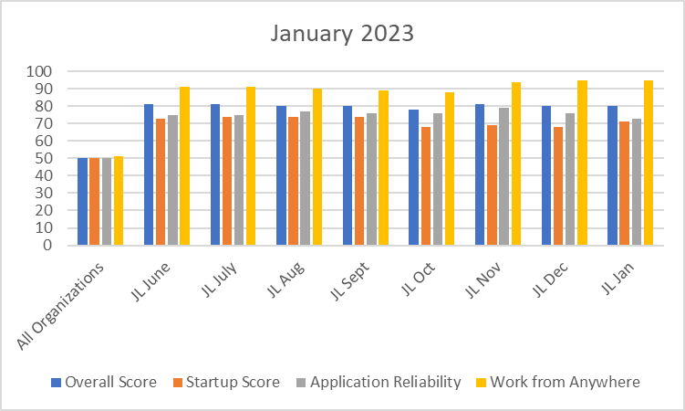
Endpoint Analytics
Overall score holding at 80 from December primarily due to Feature Updates as we push 22H2 out to the fleet.
App Reliability score of 73 due to multiple regions (Egress, Litera, ndOffice 310) in December, increasing overall process load on machines.
Work From Anywhere score hold to 95 as more of our PCs are redirected to our new SCCM CMG.

Slide 33
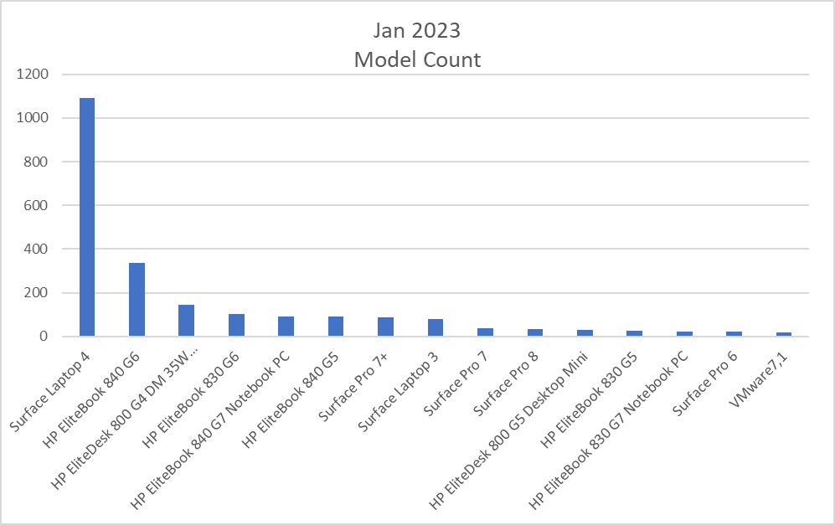
Endpoint Model Inventory
1076 units now of our Surface Laptop 4.
1076 total Surface Laptop 4s – Best overall performer
2 Remaining Surface Pro 5s - Worst overall performer

Slide 34
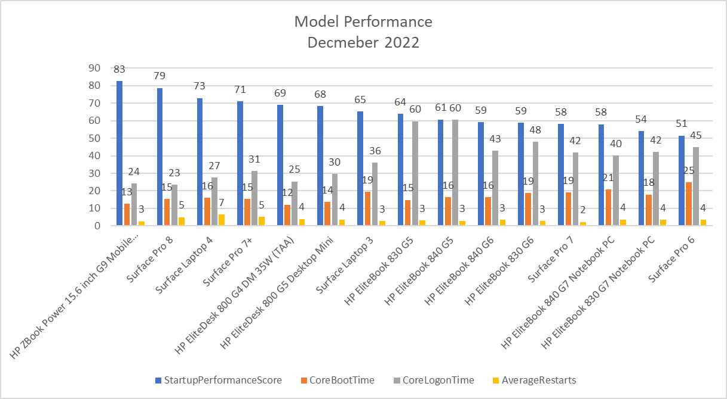
Endpoint Model Performance
Our latest models continue to lead in performance, decreasing boot and sign on times for users.
Our worst performers, HP Elitebook G5s with only 80 units remaining and to be replaced during NextGen.

